Slide 1
Obtaining Low-Level Control in a High-Level Language : Variant Types in Data-Parallel Array Languages
Presented by Luuk de Graaf
Luuk de Graaf

Slide 2
Introduction
Example

Slide 3
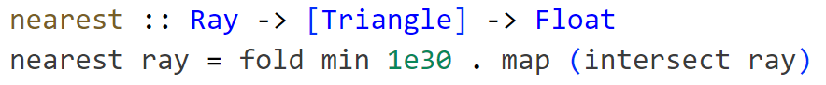
Example : casus
Array Language
Data-parallel
Raytracer intersection

Slide 4
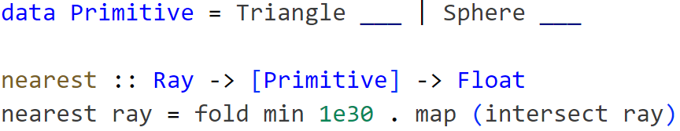
Example : solution 1 (ADT)

Slide 5
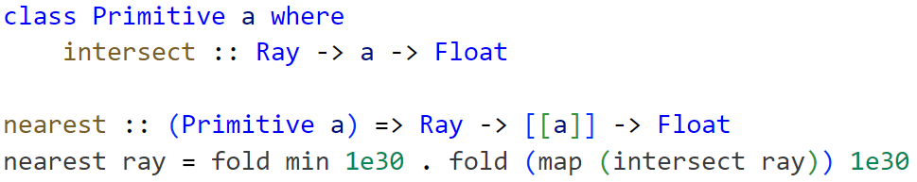
Example : solution 2 (interface)

Slide 6
Example : issue
Abstraction
Intention
Meta-programming
Low-level control
Other data structures

Slide 7
Question
How to obtain low-level control that is applicable for high performance computing, while preserving the higher-abstraction surface representation?

Slide 8
What affects performance?

Slide 9
Performance : what affects performance?
Cache
Branching/Divergence
Vectorization
CPU/GPU
Memory bound vs Compute bound
Access Pattern

Slide 10
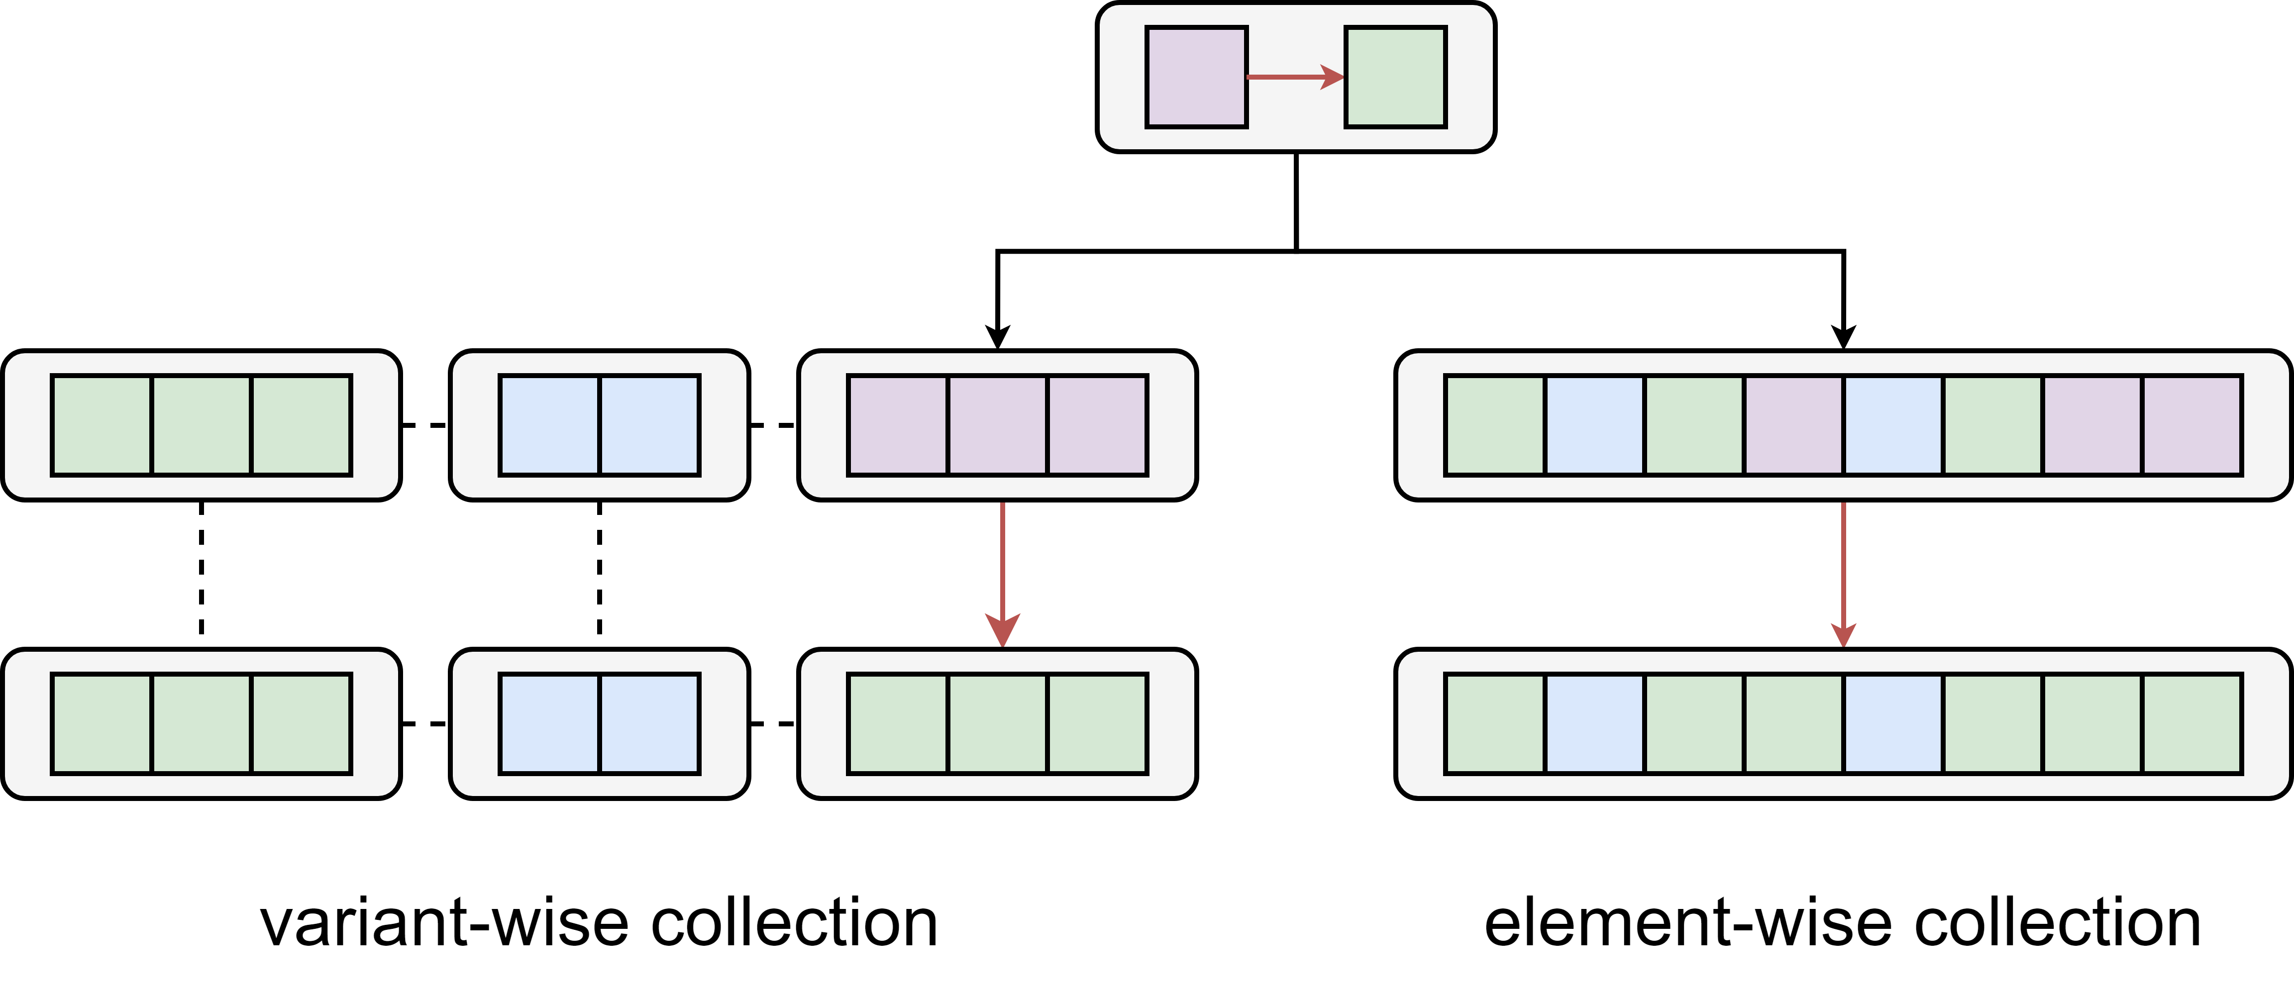
Performance : for variants, what is possible?

Slide 11
Performance : element-wise considerations
Fixed size constraint
Tagged Union vs Pointer/Index
Branching
Breaks vectorization in the general case
Masking

Slide 12
Performance : variant-wise considerations
Vectorization
Rearranging cost
Multiple functions
Variant change not independent

Slide 13
Can we abstract over it?

Slide 14
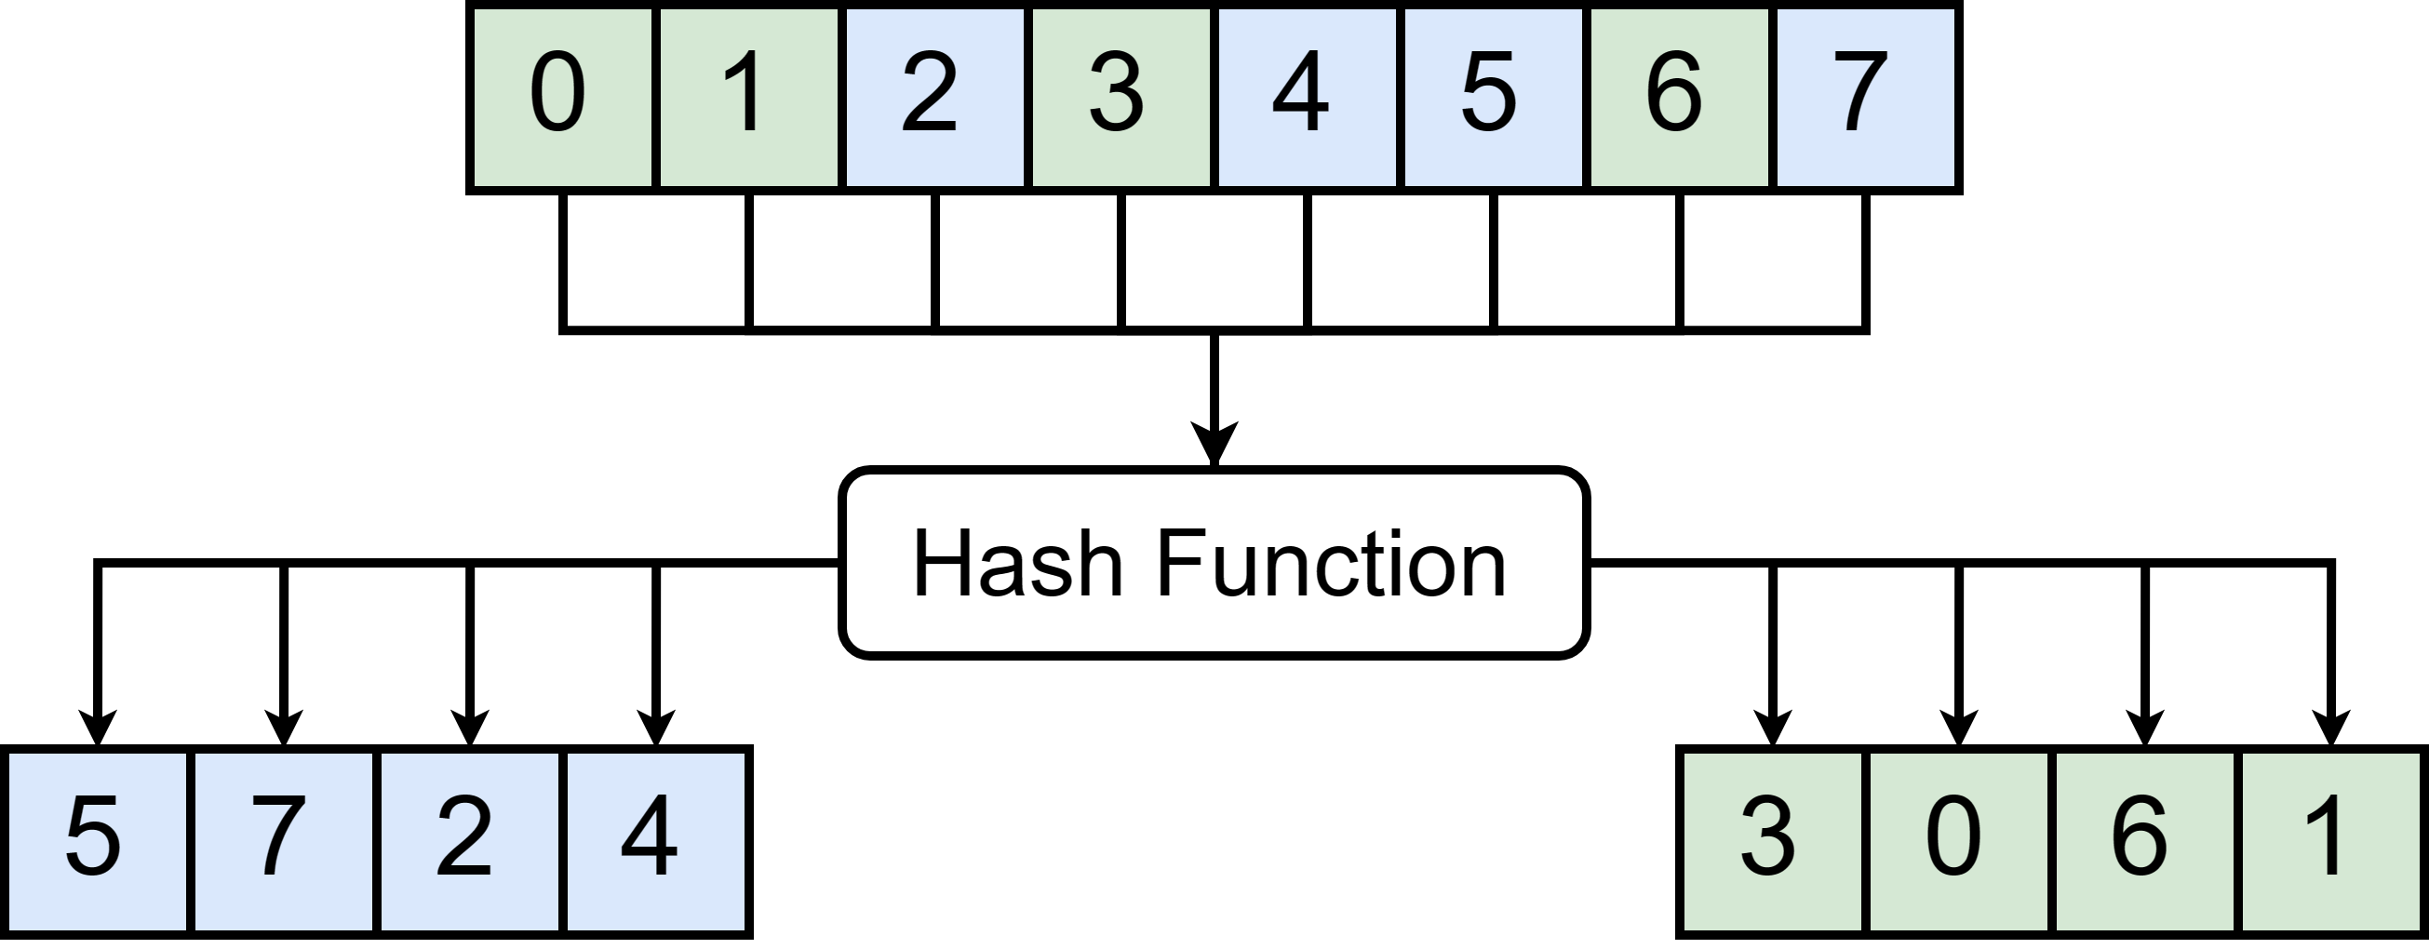
Solution : single abstraction
Functionality
Indexing

Slide 15
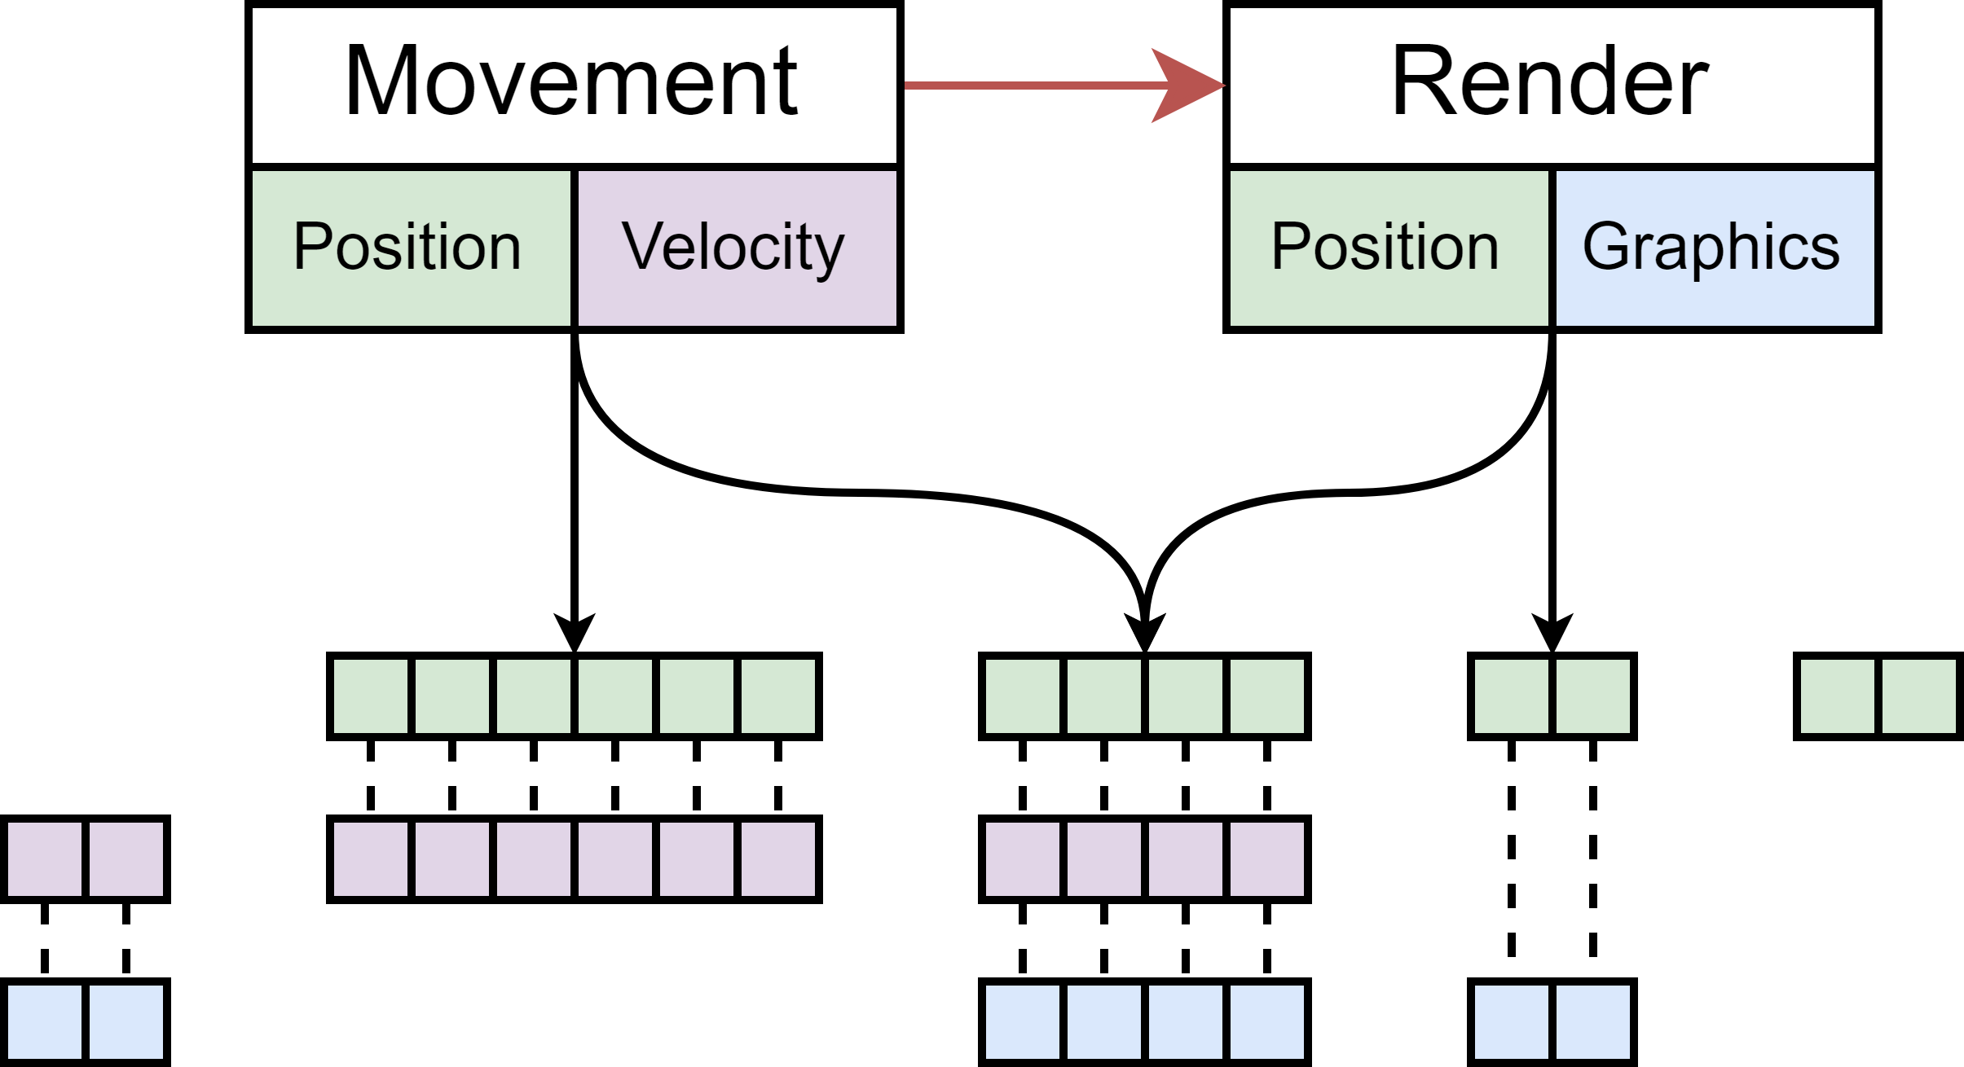
Solution : variant-wise (ECS)
Entity Component System
Composition at runtime

Slide 16
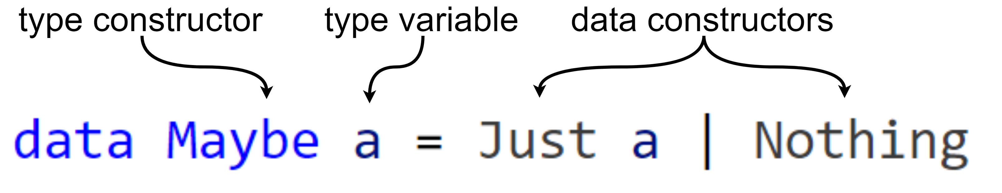
Solution : element-wise (ADT)
Functional Languages
Pattern Matching

Slide 17
Proposed Solution : Polymorphic Variants
Open/Extensible/Structural Sum Types
Polymorphic datatype
Type-level
Variants apparent to data structures

Slide 18
Polymorphic variants : introduction
Haskell
Memory Representation
Deduplication
(De)construction
Type-level and Value-level

Slide 19
Computing Types : Efficient Memory Representation

Slide 20
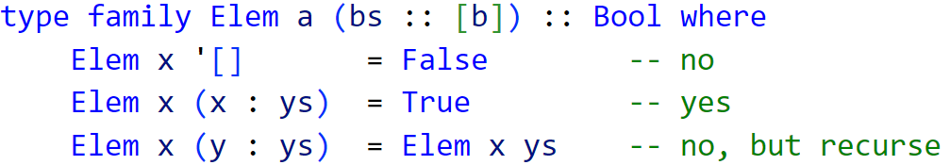
Type-level : introduction
Type-indexing
Type families
DataKinds Extension

Slide 21
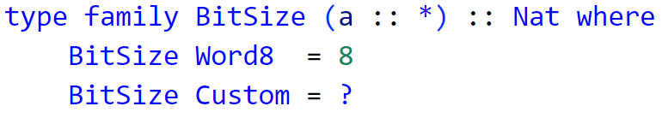
Type-Level : composition
Memory Representation
Composition explicit
Closed system
Primitive Types

Slide 22
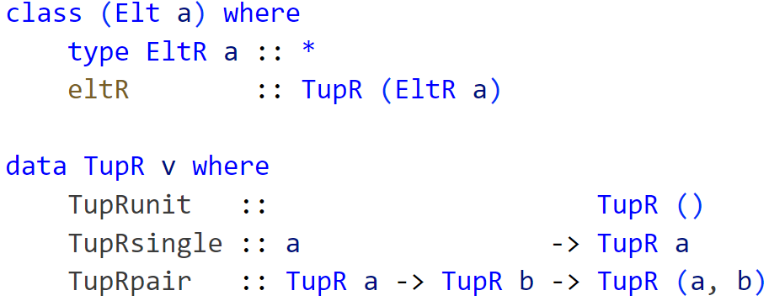
Datatypes in Embedded Languages
Abstract Syntax Tree
Constraint through GADT

Slide 23
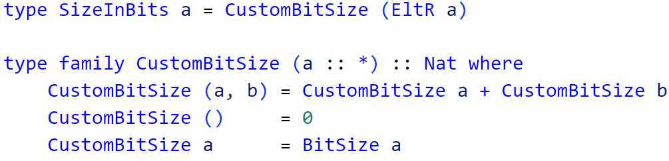
Type-Level : solution

Slide 24
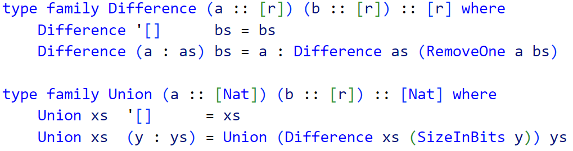
Type-Level : deduplication
Deduplication
Intermediate structure

Slide 25
Type-Level : what now?
Mapping
Type Safety
Extendable
Preserve Information

Slide 26
(De)constructing variant types

Slide 27
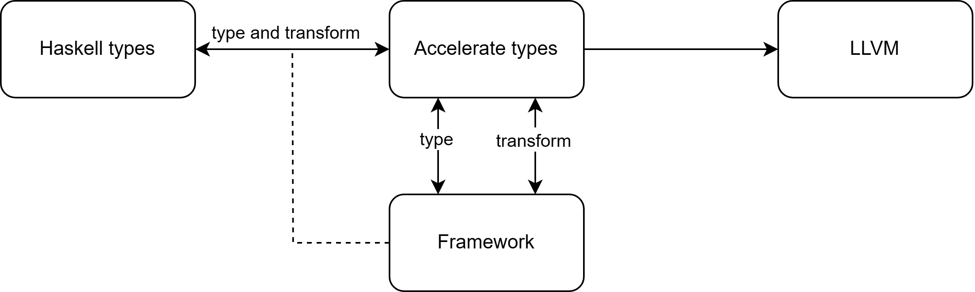
Datatype-Generic : introduction
Extending behavior
Parameterization on the composition
Goal : mapping between datatypes
(De)construction
Bitsize

Slide 28
Datatype-Generic : closed system
GADT
Refine the type

Slide 29
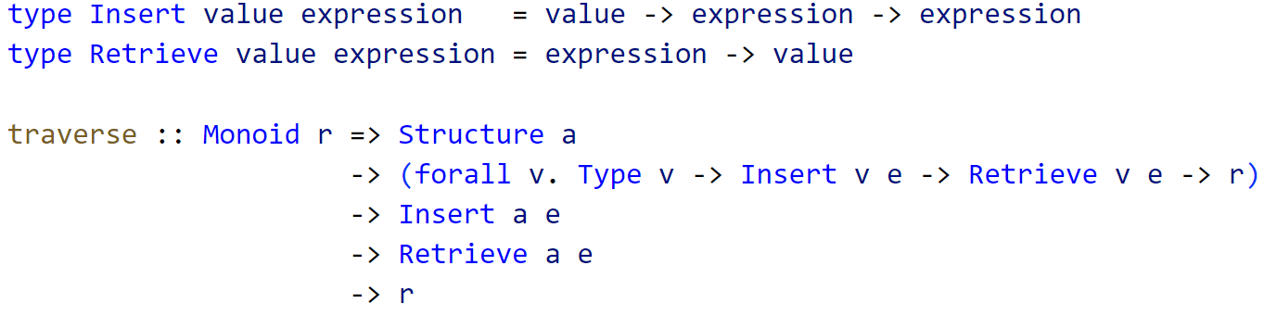
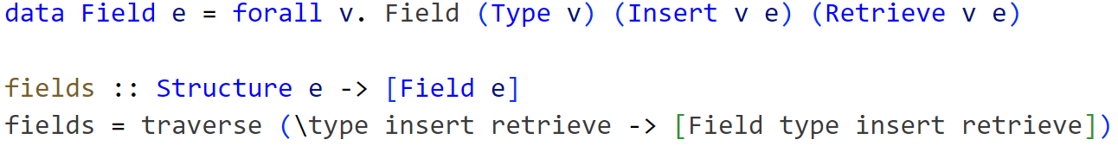
Datatype-Generic : deduplication

Slide 30
Datatype-Generic : considerations
Isomorphic
Compact
Truncation
Type Safety
Type-level sorting

Slide 31
Implementation in Accelerate

Slide 32
Implementation : introduction
Accelerate
Deeply Embedded
Disconnection between Surface and Embedded
Embedded Pattern Matching

Slide 33
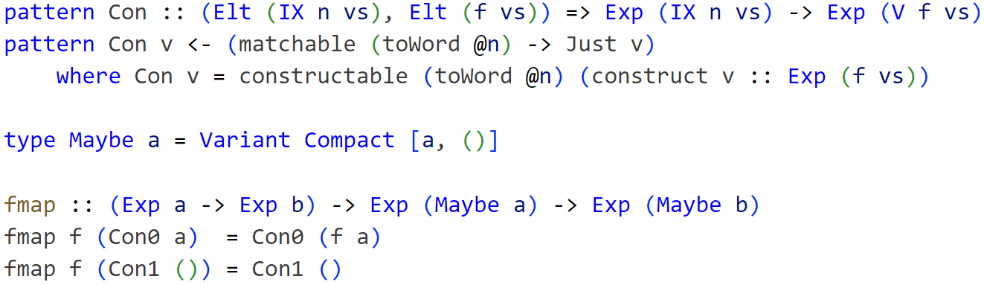
Implementation : pattern synonyms

Slide 34
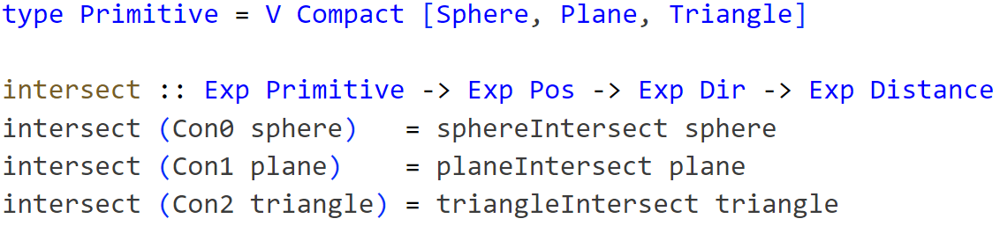
Implementation : result
Memory Representation
(De)constructors
Data structures

Slide 35
Notes:
Any questions?

